Slide 1

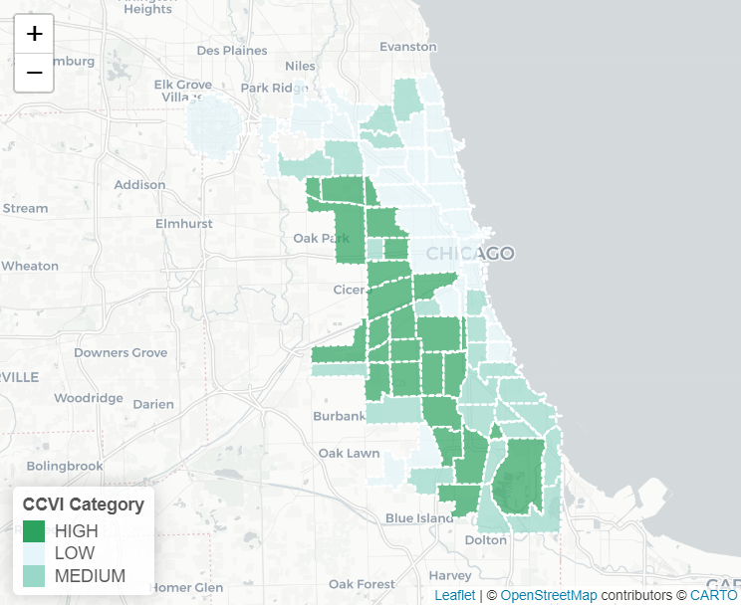
In the space below to copy/paste/insert a custom version (new color palette) of Figure 1 (map of CCVI Scores by Community Area) from the exercise.
GEO 3330 Sustainable Urban Transportation
Exercise #2: L Station Ridership Trends
Describe here any patterns you see in the map. Use data from the map to describe characteristics of at least one community located within each of the three CCVI categories.
Austin: CCVI is high, socioeconomic ranking is 59
South Shore: CCVI is med, SE ranking is 48
Hyde Park: CCVI is low, SE ranking is 16
I see a direct correlation between SE ranking and CCVI status

Slide 2
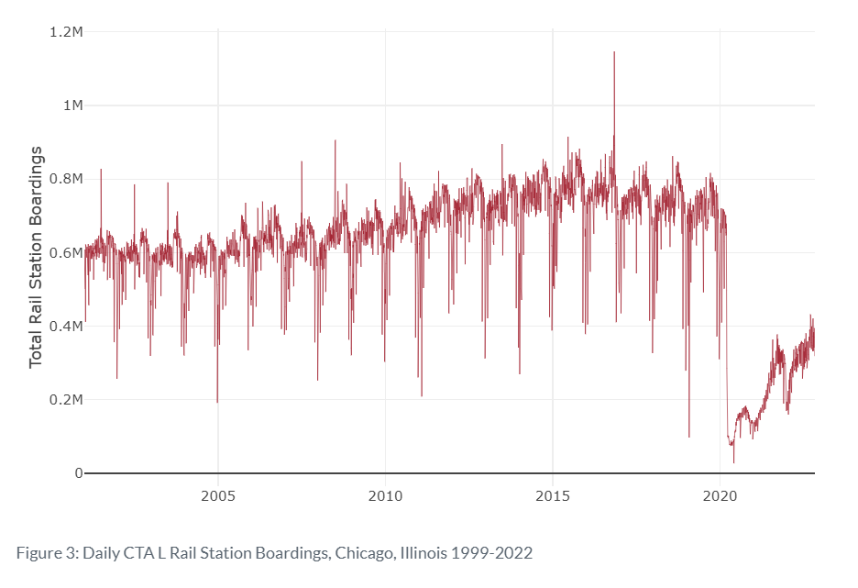
In the space below to copy/paste/insert Figure 2 or 3 from the exercise.
GEO 3330 Sustainable Urban Transportation
Exercise #2: L Station Ridership Trends
Describe patterns in rail boardings between 1999 and 2022. What do you think explains some of the cyclical variations in the data? What other factors may explain ridership over this period? Draw from the daily ridership plot to characterize ridership trends during the pandemic.
The cyclical variations are definitely the difference in ridership between winters and summers. Some of the big peak days are big events like the cubs WS parade in 2016. The pandemic demolished ridership levels and they are still on the way back to where they were.

Slide 3
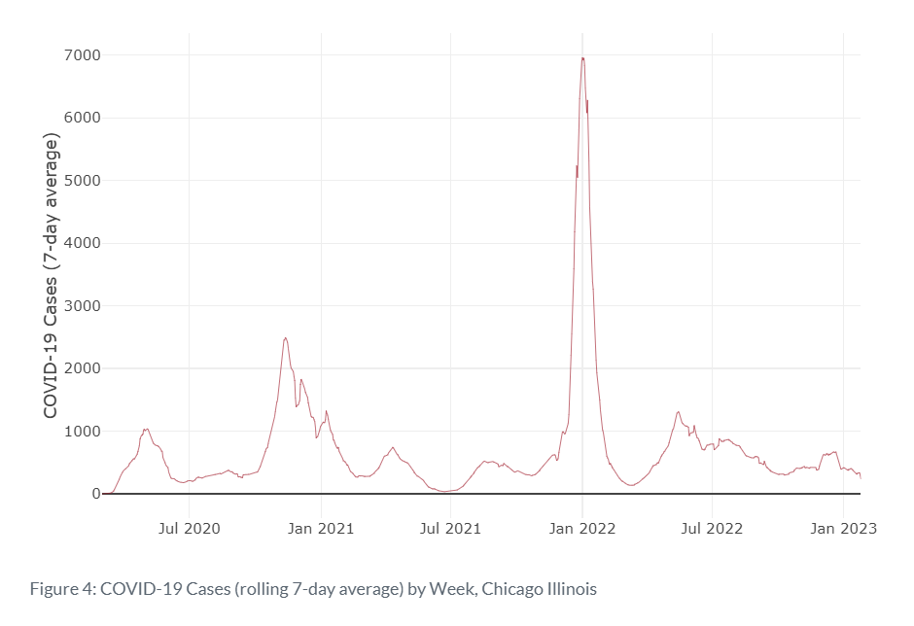
In the space below to copy/paste/insert Figure 4 from the exercise.
GEO 3330 Sustainable Urban Transportation
Exercise #2: L Station Ridership Trends
Are the waves and phases of the pandemic evident? Compare these pandemic phases to ridership trends over the same period. Do they appear to be related?
It appears that the waves and phases are related. The first bump is the original strain, second few are delta, the biggest one and afterwards is omicron. There appears to be slight effects on ridership as there is a dip in ridership when delta and omicron hit respectively.

Slide 4
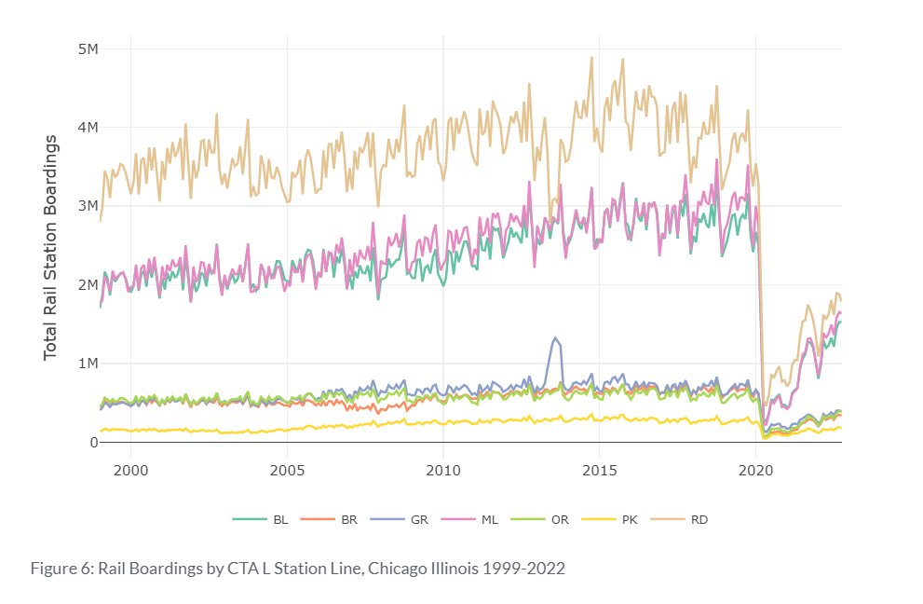
In the space below to copy/paste/insert Figure 5 or 6 from the exercise.
GEO 3330 Sustainable Urban Transportation
Exercise #2: L Station Ridership Trends
How does ridership vary with respect to station CCVI and line?
I believe the top 2 lines are red, blue, and idk what “ML” means. These lines run mainly through low CCVI areas and they have the most ridership. They are also bouncing back quicker than the others. Higher risk = lower ridership it seems.

Slide 5
Summarize some potential short- and longer-term implications the pandemic has had on sustainable transportation and public transit ridership?
I think it has made some people work from home more so there are less commuters, this is both short and long term. Then theres the fact that the pandemic made us develop habits and maybe being on public transit is seen as gross now because of the pandemic and being around other strangers. There also is greater wealth disparity because of covid, meaning that there may actually be more dependence on the L in poorer areas.
GEO 3330 Sustainable Urban Transportation
Exercise #2: L Station Ridership Trends
What strategies do you propose to help return transit to pre-pandemic levels?
I believe we should decrease the fares, increase property taxes in the top richest neighborhoods to pay back the cta, expand the L into the far south side and back to where it used to be on 63rd, and honestly do more promoting to remind people that the L is there. Maybe also offer free cta passes for the most vulnerable of the population.

